Slide 1



UNIFIED MENTOR
Amazon Sales Data Report
Prepared by Shravani Chandane

Slide 2


Introduction
This presentation outlines the trends and key findings from the Amazon Sales Data analysis for the project titled "Analyzing Amazon Sales Data" focusing on the period from 2010 to 2017. The analysis utilized Power BI for ETL, data manipulation tasks, and visualizations .

Slide 3


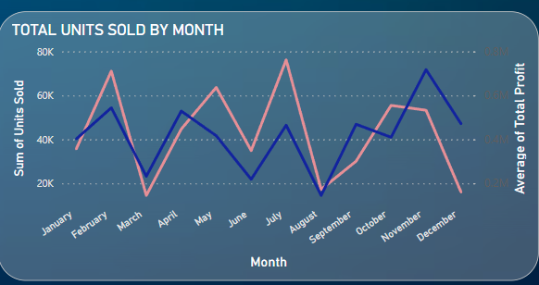
Analysis Overview
High-Level
Trends
Sum of Units Sold Dynamics
- July had the highest units sold at 76,201, marking a 425.63% increase compared to March, which had the lowest at 14,497.
- A notable trend is the decline starting from 2012, with a decrease of 49.75% over 5 years.

Slide 4
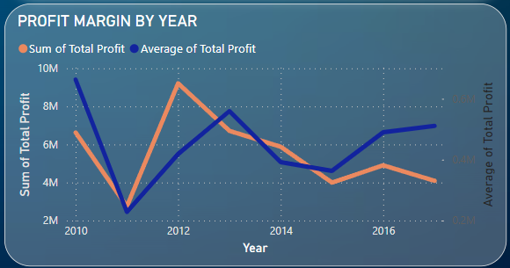
High-Level
Trends
Profit Trends
- Total Profit and Average Profit have both shown a declining trend from 2010 to 2017, with Total Profit falling by 38.32% and Average Profit by 22.90%.
- The steepest profit decline occurred between 2010 and 2013, from $662,956 to $559,618.

Slide 5
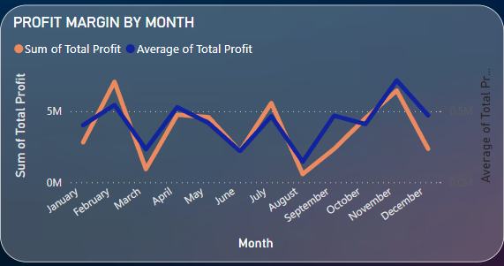
High-Level
Trends
Monthly and Seasonal Variations
- The highest total profit was in February at $7,072,051, which was 1,120.84% higher than the lowest in August at $579,277.
- February alone accounted for 16.01% of the annual Sum of Total Profit.

Slide 6
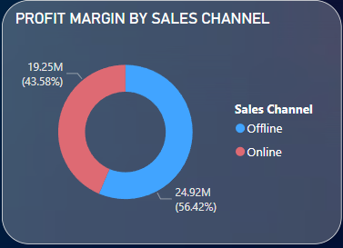
High-Level
Trends
Sales Channel Performance
- Offline sales channels outperformed online channels in both the sum of units sold and total profits.
- Most sales channels remained below 5,129 in sum of units sold and $441,682 in average total profit.

Slide 7
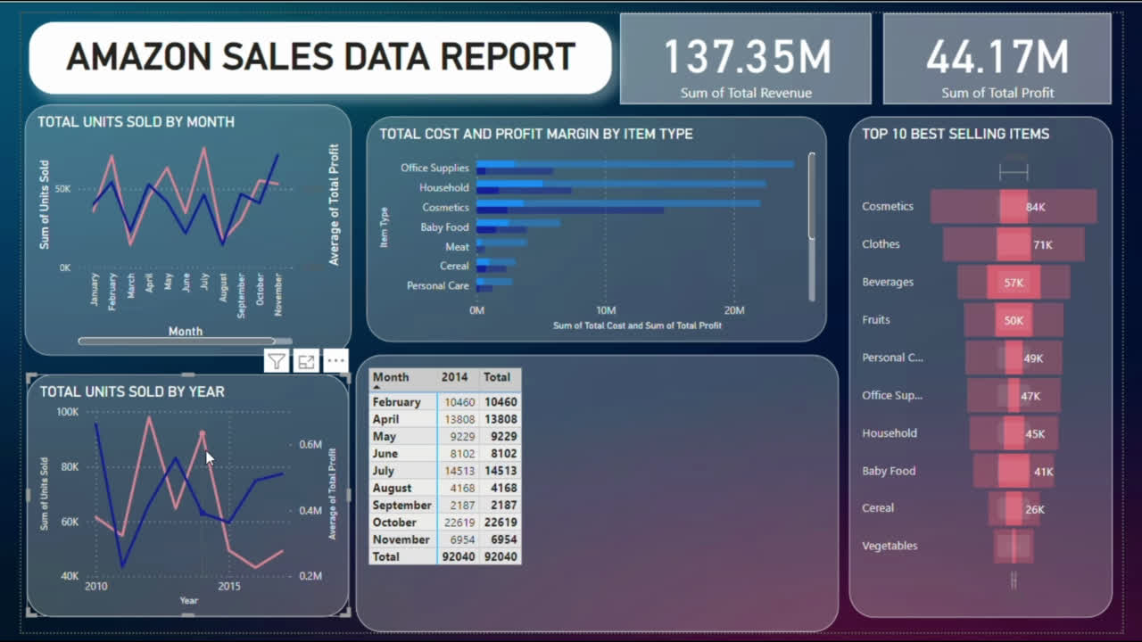
POWER BI REPORT

Slide 8

Correlation Between Metrics
- Both Sum of Units Sold and total Average of Total Profit are positively correlated.
- The largest variance between Sum of Total Profit and Average of Total Profit was in February, where Sum of Total Profit was $6,528,047 higher than Average of Total Profit.
Item Type Analysis
Detailed Observations
- Across all 12 item types, the total cost ranged from $345,986 to $24,655,796, and total profit ranged from $120,495 to $14,556,049.
Sales Channel Details
- Offline had the highest metrics, with 9,925 units sold and the highest average total profit of $1,719,922.
- The total profit with the highest sum of units sold was $951,411.

Slide 9
DECLINING PROFITABILITY
There is a clear downward trend in both Sum of Total Profit and Average of Total Profit from 2010 to 2017, indicating potential issues in pricing, cost management, or increased competition.
SEASONAL VARIABILITY
Significant variations in sales and profit figures across different months suggest that seasonal factors strongly influence performance, with February being particularly strong.
Conclusions
CHANNELS
Offline channels continue to dominate in terms of both sales volume and profitability, pointing to possible areas for online strategy enhancement.

Slide 10

Recommendations
Capitalize on the high performance observed in February by planning marketing campaigns around this time.
Seasonal Campaigns
Review Pricing Strategies
Boost Online Presence
Given the continuous decline in profit, a review of pricing strategies and perhaps cost structures is recommended.
Strategies to enhance online sales should be considered, focusing on competitive pricing, customer experience, and digital marketing.

Slide 11

Closing Remarks
The data-driven insights from the Amazon Sales analysis provide a strong foundation for strategic decisions aimed at improving sales performance and tackling the challenges observed over the years. Implementing the recommendations could be crucial in turning around the downward trends in profit.

Slide 12



Thank you
Github
LINK
LinkedIn
LINK

